Slide 1
Drowsy Driving
Provided by: Barton Insurance Group LLC
© 2022 Zywave, Inc. All rights reserved.

Slide 2
Learning Objectives
It’s vital to avoid dangerous behaviors behind the wheel, such as driving while drowsy. In this presentation, you will learn:
What drowsy driving is
What causes drowsy driving
Why drowsy driving is dangerous
How to recognize the signs of drowsy driving
How to stay alert on the road and prevent drowsy driving

Slide 3
What Is Drowsy Driving?
Drowsy driving refers to the act of operating a motor vehicle while sleepy or fatigued. Such an act can limit your ability to drive safely and increase the risk of being involved in a vehicle accident.
Several studies have shown that drowsy driving is similar to driving while under the influence. In particular, a clinical trial found that staying awake for 17-19 hours and then getting behind the wheel is comparable to having a blood alcohol content (BAC) of 0.05% while driving, whereas going even longer periods (i.e., more than 20 hours) without sleep is roughly equivalent to having a BAC of 0.1%—the latter of which surpasses the legal BAC limit of 0.08%.

Slide 4
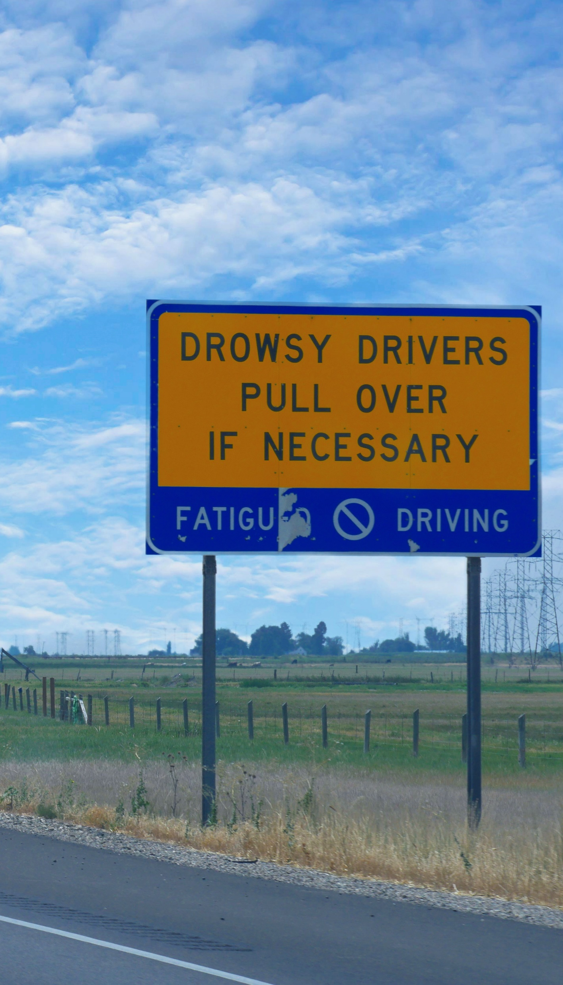
What Is Drowsy Driving? (Continued)
In some cases, drowsy driving may lead to microsleep, which entails dozing off for a short period of time—generally, four to five seconds.
Microsleep often happens so quickly you may not even realize you dozed off. During a microsleep episode, you may still appear awake, but your brain won’t be able to process information.
Experiencing microsleep behind the wheel can substantially elevate the likelihood of running your vehicle off the road or being involved in a collision, especially if you are driving at high speeds when it occurs.

Slide 5
Causes of Drowsy Driving
Drowsing driving can be caused by a range of factors, including the following:
Sleep deprivation—A lack of ample sleep is the leading cause of drowsy driving. According to the Centers for Disease Control and Prevention, more than one-third (35%) of U.S. adults aren’t getting enough sleep each night.
Sleep disorders—Various sleep disorders (e.g., insomnia, narcolepsy and sleep apnea) can lead to restricted, interrupted or less restorative sleep patterns. If these disorders go undiagnosed or untreated, they could contribute to drowsy driving.
Substances—In addition to impacting decision-making capabilities and reaction time behind the wheel, drinking alcohol can also lead to drowsy driving. Further, taking certain prescription drugs, medications or dietary supplements could cause sleepiness on the road.

Slide 6

Causes of Drowsy Driving (Continued)
Apart from the primary causes of drowsy driving, it’s important to note that accidents stemming from such impaired driving are more common at certain times of the day—namely, between midnight and 6 a.m. and during the midafternoon.
Additionally, drowsy driving is increasingly prevalent among those who have less experience on the road and work long hours, irregular shifts or evening shifts.

Slide 7
The Dangers of Drowsy Driving
Driving while drowsy can make paying attention to the road increasingly difficult and negatively impact your ability to make smart decisions. Drowsy driving can also significantly reduce your reaction time behind the wheel, particularly if you need to brake or steer suddenly.
According to the National Highway Traffic Safety Administration (NHTSA), nearly 100,000 police-reported crashes occur due to drowsy driving each year—resulting in approximately 50,000 injuries and 800 fatalities.

Slide 8

The Dangers of Drowsy Driving (Continued)
Despite the NHTSA’s police-reported findings, some studies suggest that the total number of accidents stemming from drowsy driving is even higher. According to the AAA Foundation for Traffic Safety, 328,000 crashes caused by drowsy driving happen annually, contributing to 109,000 injuries and 6,400 fatalities.
Overall, the National Center for Biotechnology Information estimates that more than one-fifth (21%) of fatal crashes result from drowsy driving.

Slide 9

Signs of Drowsy Driving
When behind the wheel, be sure to monitor yourself for the following signs of drowsy driving:
Yawning or blinking frequently
Struggling to keep your eyes open or hold your head up
Nodding off or not remembering the last few miles of driving
Missing road signs, exits or turns
Drifting away from your lane or driving over “rumble strips” on the road
Following other vehicles too closely or having a hard time maintaining your speed

Slide 10
Drowsy Driving Prevention
Follow these best practices to stay alert on the road and avoid drowsy driving:
Try to get between seven and nine hours of sleep each night by sticking to a consistent routine. If you are feeling overly tired during the day, snoring frequently during sleep or having difficulty falling or staying asleep at night, consult your doctor to determine whether you are experiencing a sleep disorder and require treatment.
Refrain from driving while under the influence of drugs or alcohol. Check the labels on any medications or supplements you are taking to ensure these substances don’t cause sleepiness. Switch to non-drowsy alternatives as needed.
Drink plenty of water and eat a healthy snack or meal prior to your driving shifts to keep yourself feeling energized.
Allot for ample breaks throughout your driving shifts to limit the risk of fatigue.
Talk to your supervisor about adjusting your schedule or driving with another employee if you have been feeling overly tired during or after your shifts.

Slide 11

Drowsy Driving Prevention (Continued)
Don’t rely on certain “tricks” to stay awake, such as adjusting the windows, fiddling with the air conditioning or turning up the radio. These so-called tricks can end up distracting you from the road and posing additional safety hazards.
Take all signs of drowsy driving seriously. If you feel sleepy or fatigued behind the wheel, pull over to a safe location and take a 15-20 minute nap. If possible, change drivers.
Comply with all company policies and procedures regarding drowsy driving prevention.

Slide 12
Summary
Overall, it’s evident that driving while drowsy is a major safety concern that could put you and others at risk on the road—potentially leading to serious crashes, injuries and even fatalities.
By having a better understanding of drowsy driving, its associated causes and ways to prevent it, you can effectively uphold safe habits behind the wheel and minimize possible accidents.

Slide 13
For More Information
For further information regarding drowsy driving prevention or other safety topics, please contact:
Barton Insurance Group LLC
www.bartoninsurancegroupllc.com
615.806.1265

